Slide 1
TOPIC- DIGITAL SCANNER Group #3 Member: 1.Nick Grim 2.Andrea Maartinez 3.Moritz Pfatteicher 4.Bruce Rayner 5. Juliet Coston

Slide 2

SCANNING DEVICES
Copy data form source scanners can take paper and convert it into a bitmap
Type of Scanners
Optical Scanner
Bar Code reader
Character and Mark recognition

Slide 3
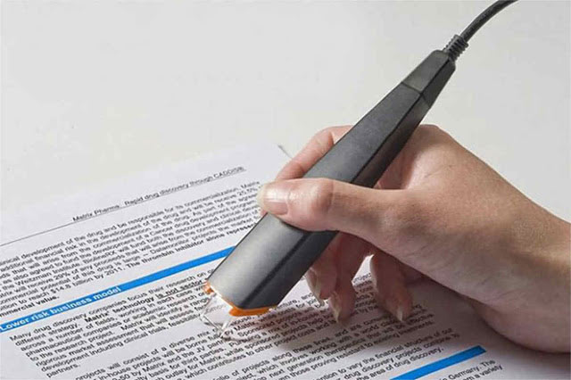
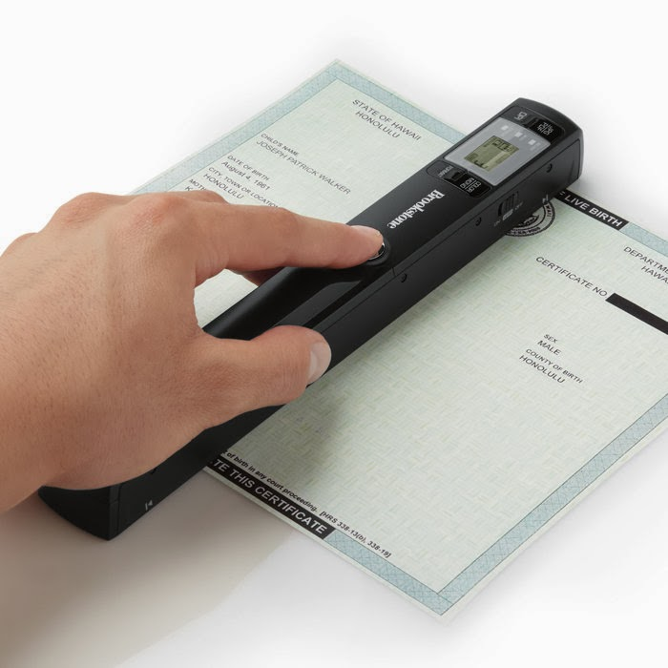
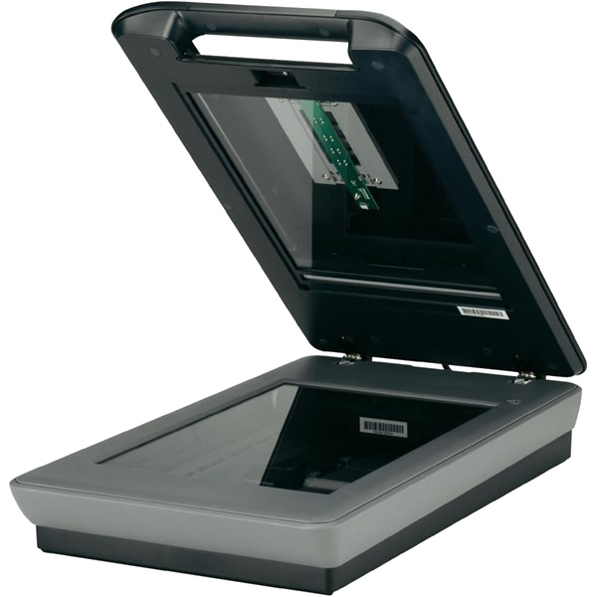
1.OPTICAL SCANNER
Its convert text or drawing into machine and make it readable format.
It can be displayed, printed or even stored the data.
Types of optical scanner
1.Flatbed scanner-Paper placed on a glass surface and the image scanned from below.
2 portable Scanner handheld device that slides across the paper or a book.
This Photo by Unknown author is licensed under CC BY-SA-NC.
This Photo by Unknown author is licensed under CC BY-NC.
This Photo by Unknown author is licensed under CC BY-SA-NC.

Slide 4
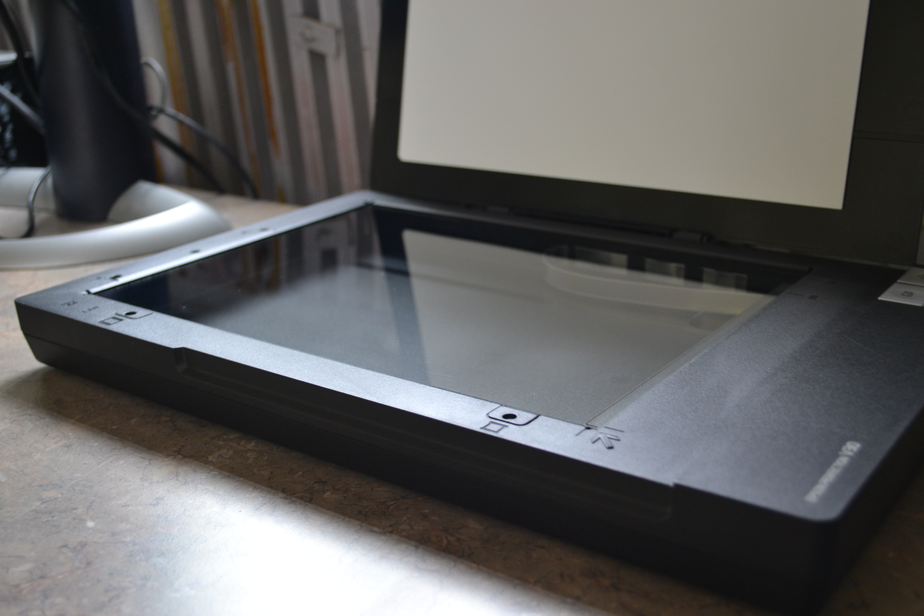
Flatbed SCANNER
A flatbed scanner is an optical scanner which makes use of a flat surface for scanning documents. The scanner is capable of capturing all elements on the document and does not require movement of the document. Flatbed scanners are effective scanners for delicate materials such as vintage photographs, papers and other documents which are fragile.
This Photo by Unknown author is licensed under CC BY-SA-NC.

Slide 5
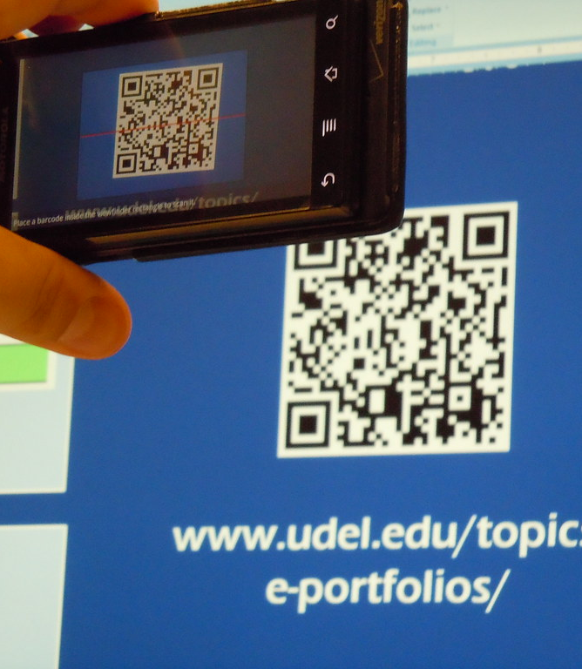
BAR CODE SCANNER and QUR CODE
Photoelectric scanner
Using a light beam scans the items and changes it into electrical impulses for the processing .
Reading bar codes
Alternating black &white vertical bars
Universal product code (UPC)
You can see these at grocery store, retail stores , and at school.
This Photo by Unknown author is licensed under CC BY.

Slide 6
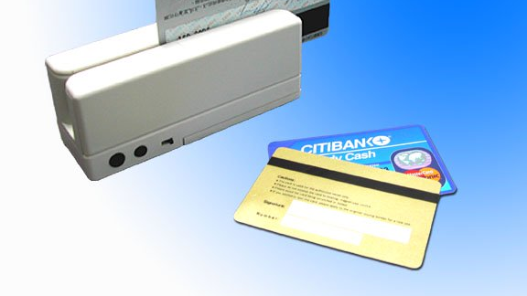
Magnetic Strip card
Magnetic strip card has a magnetically encoded data on its back. The magnetic strips are used in many plastic cards such as personal identity cards. The magnetic strip can store the personal details of the card owner. It can be used to access secure information such as bank account details etc.
This Photo by Unknown author is licensed under CC BY-SA-NC.

